Slide 1
Import Workflows (Galaxy/CWL) into TeSS Concept Maps
BioHackathon 2018 - Paris
http://bh2018paris.info/
Proponent: Niall Beard
University of Manchester / ELIXIR-TeSS
Project links
[Concept Maps](http://tess.oerc.ox.ac.uk/concept_maps)
[BioHackathon Folder](http://bit.ly/2PhjXVr)
[Concept Maps code](https://gl.cs.ut.ee/inkuzmin/workflows-js)

Slide 2
Background information

Slide 3
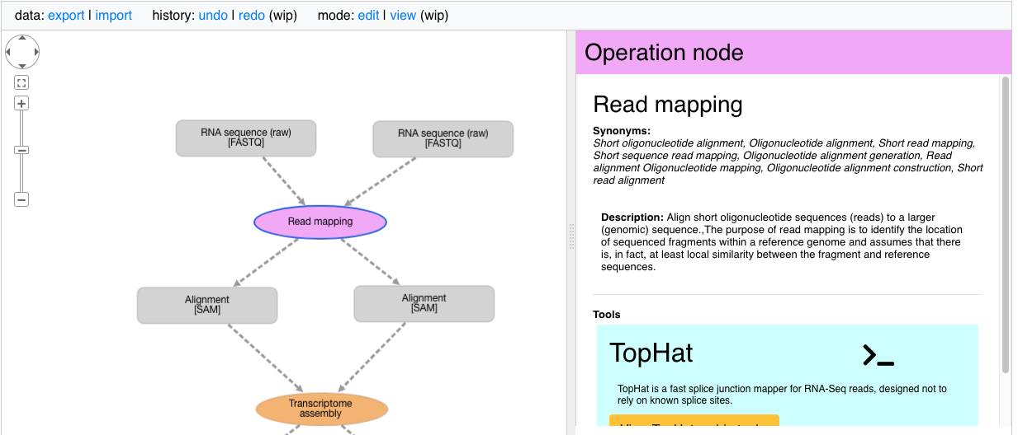
Background
TeSS has developed a new Training tool called Concept Maps.
Concept Maps provides a simplified representation of a typical Bioinformatics Workflow.
They are composed of connected, alternating Data and Operation steps.
Notes:
Condense technical workflows into a simplified, conceptual representation
Break it down – Data feeds into Operation. Operation returns data. And so on

Slide 4
Background
TeSS has developed a new Training tool called Concept Maps.
Concept Maps provides a simplified representation of a typical Bioinformatics Workflow.
They are composed of connected, alternating Data and Operation steps.
Data steps contain:
Educational information about what data is used (in markdown format)
Appropriate EDAM Data/Format terms
Links to databases/standards/specifications from FAIRSharing.org
Training materials in TeSS
Operation steps contain:
Educational information about what, why, and how to perform this operation
Applicable EDAM Operation terms
Links to bio.tools resources that can be used to complete this step.
Training materials in TeSS
Notes:
Description is context specific
Not only to TEACH with, but also to INFORM of available resources. Acts as a

Slide 5
Motivation for the Biohackathon project
Lots Workflows in Galaxy and CWL
Few Concept Maps in TeSS (we’ve just finished implementing it!)
Training is important! Concept Maps help…
…Researchers/developers understand workflows
Use them appropriately, correctly, & contribute back to
…Workflows become more widely adopted
More educational resources helps spread adoption
So, the aim is to make new Concept Maps in TeSS by importing Workflows into the editor; ready to be turned into real training materials.

Slide 6

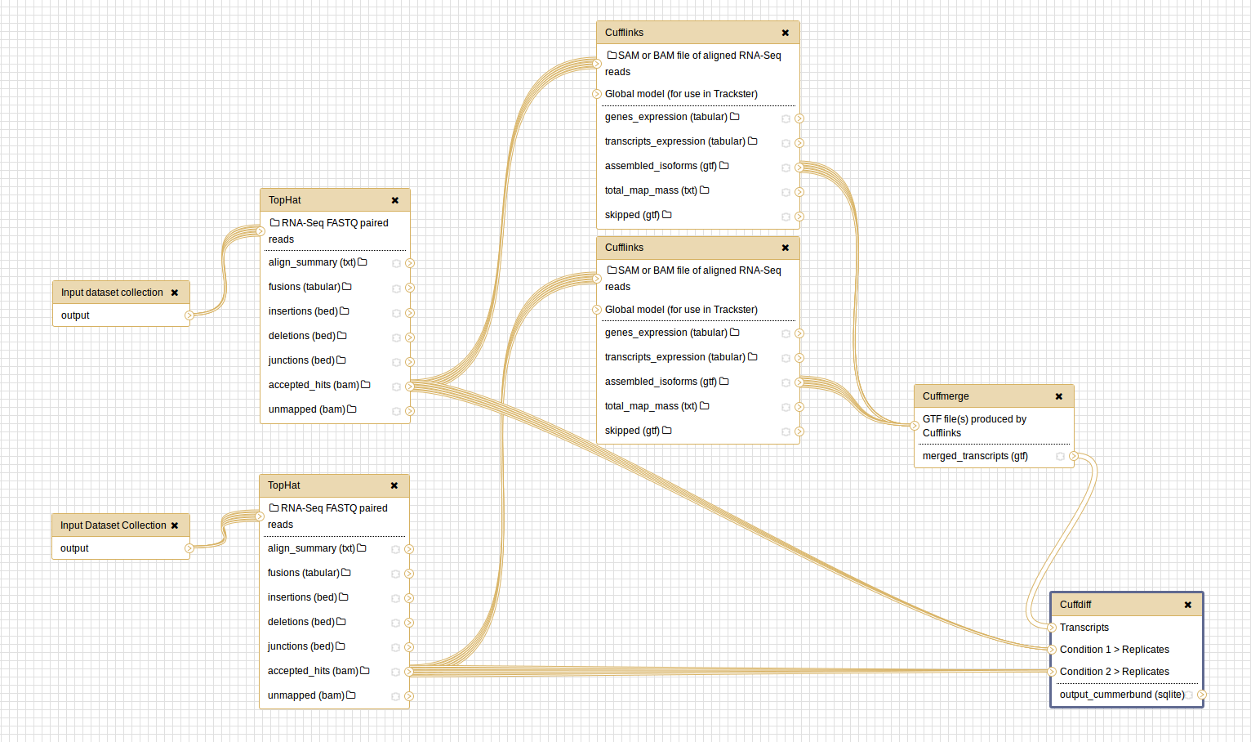


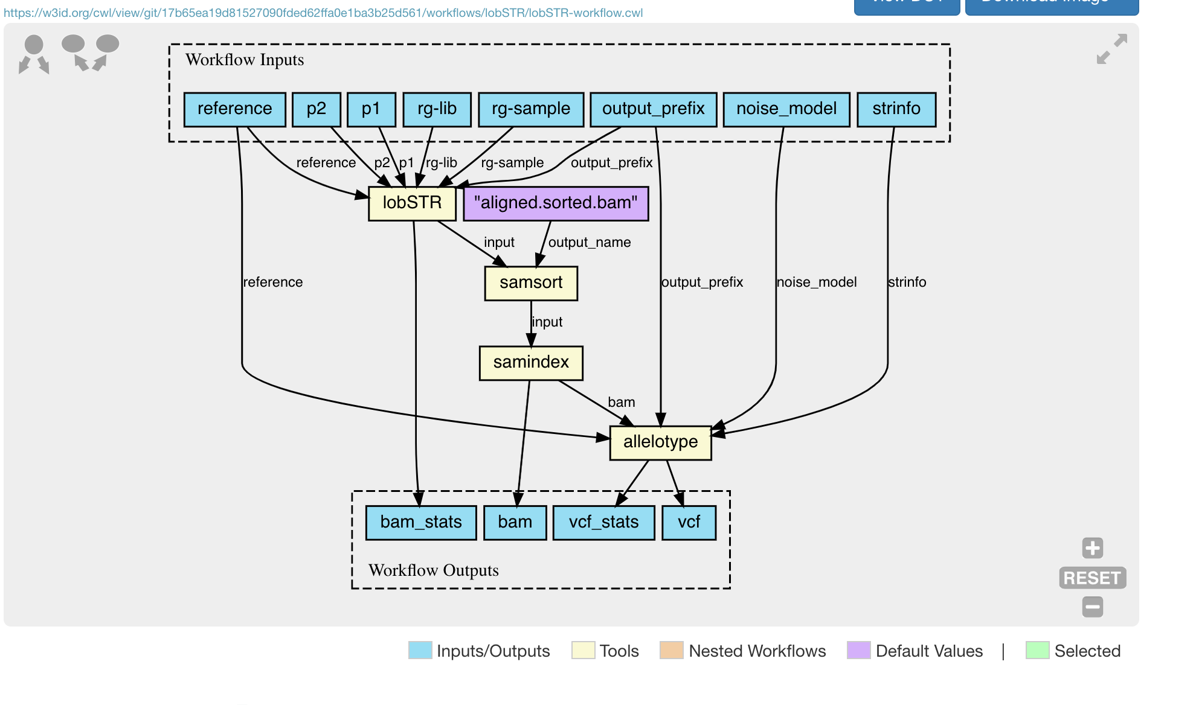
Motivation for the Biohackathon project
Import
import

Slide 7
Goals of the hacking project

Slide 8
Goal and expected outcome
General goal of the hacking project
Import Galaxy/CWL Workflows into TeSS
Expected results at the end of the hackathon
M1: Exploration/Proof of Concept
M1.1 Identify an appropriate Workflow (Galaxy/CWL/other)
M1.2 Author a new Concept Map training material based on this workflow
M2: Automatically import workflow into Concept Map
M2.1: Create a Workflow parser to parse a workflow
M2.2: Generate a Concept Map in TeSS from the information in the parsed Workflow
M2.3: Add a description and associate bio.tools, fairsharing, and TeSS resources.

Slide 9
Post-biohackathon perspectives
After the hackathon:
Completion of a Workflow-2-ConceptMap importer will allow us to generate skeletons of Concept Maps easily.
We can work with communities to turn common workflows into new training materials
Experiences today can be used to improve the Concept Map application in the future
Further:
How Tool/Training metadata and/or Ontology classifications might be incorporated back in to workflow specification.

Slide 10
Hack organisation

Slide 11
Organisation of the hacking project
Duration: 3/4/5 hacking days
Project representation at the biohackathon
[Niall Beard] ELIXIR-TeSS Project Manager
Invited resource people and associated expertise
[Ivan Kuzmin](https://github.com/inkuzm) ConceptMap Developer
Call for additional expertise from biohackathon attendees
Critical - GALAXY / CWL Specification experts!
High Priority – Anyone interested in training and/or workflow authors
High Priority – Hackers! Languages will primarily be JavaScript + Ruby/Python
Very welcome – Everyone

Slide 12
Steps and tasks
Expected results at the end of the hackathon
M1: Exploration/Proof of Concept
M1.1 Identify an appropriate Workflow (Galaxy/CWL/other)
M1.2 Author a new Concept Map training material based on this workflow
M2: Automatically import workflow into Concept Map
M2.1: Create a Workflow parser to parse a workflow
M2.2: Generate a Concept Map in TeSS from the information in the parsed Workflow
M2.3: Add a description and associate bio.tools, fairsharing, and TeSS resources.

Slide 13
Contact and links
Contact (s)
[Niall Beard] (niall.beard@manchester.ac.uk)
Links related to the project
[Github Page](http://bit.ly/2PhjXVr)
[Concept Map Work](http://tess.oerc.ox.ac.uk/concept_maps)
[Concept Map JS](https://gl.cs.ut.ee/inkuzmin/workflows-js)

